Slide 1
Object Oriented Programming Introduction
CS(217) Object Oriented Programming

Slide 2
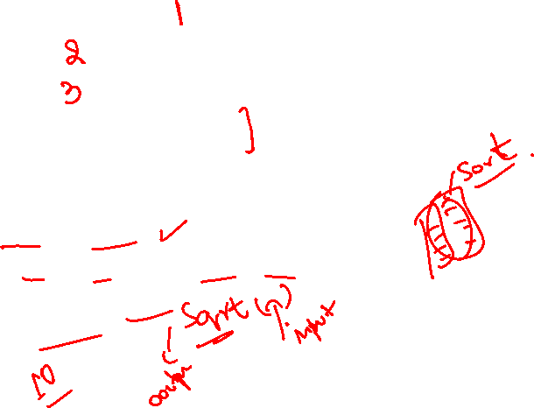
Procedural or Structured Programming
Centered around procedures (functions)
  Take data as parameters
  Process data
  Return results
Provide procedural abstraction
  Hide low level implementation details from user
  Examples:
    Search (Linear or Binary)
    Sorting (Bubble, Selection , Even-Odd, Insertion)
    Square Root Calculation
    Prime Numbers

Slide 3



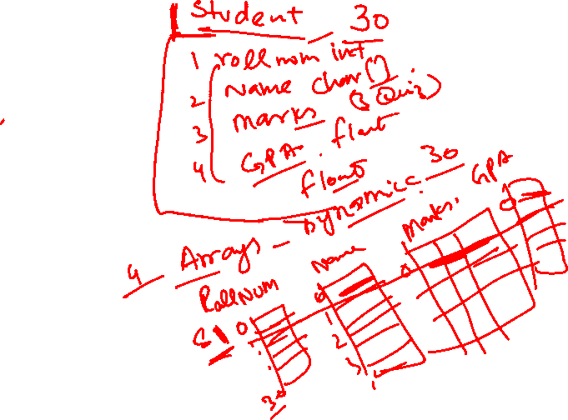
What’s Wrong with Procedural Programming?
Complex programs
Programs are difficult to modify and extend
Examples Management Systems
  Student
  Health Care
  Inventory
  Library

Slide 4
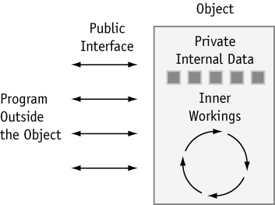
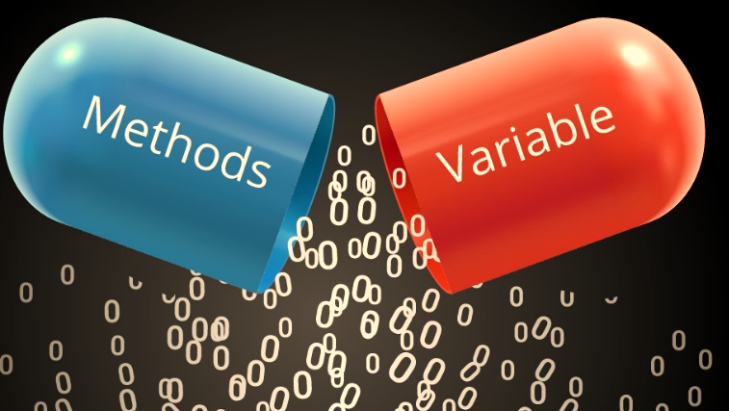
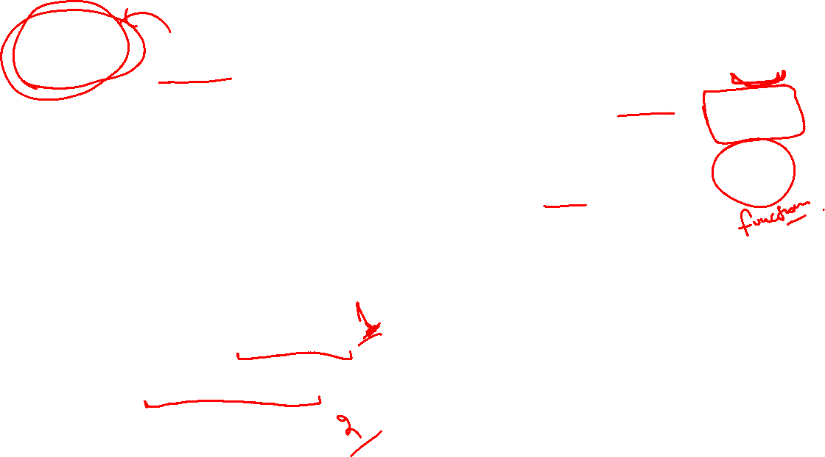
Object Oriented Programming
Centered around Objects
An Object has combined
  Data storage
  Functions
Provides Encapsulation
  Information and implementation hiding
Provides Abstraction
  Data abstraction
    Hide low level storage details
  Procedural abstraction
    Hide implementation of an action and low level functional details

Slide 5
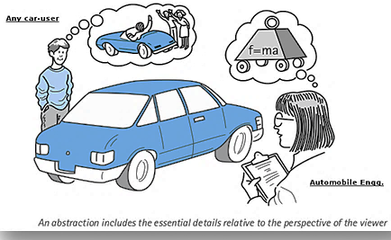
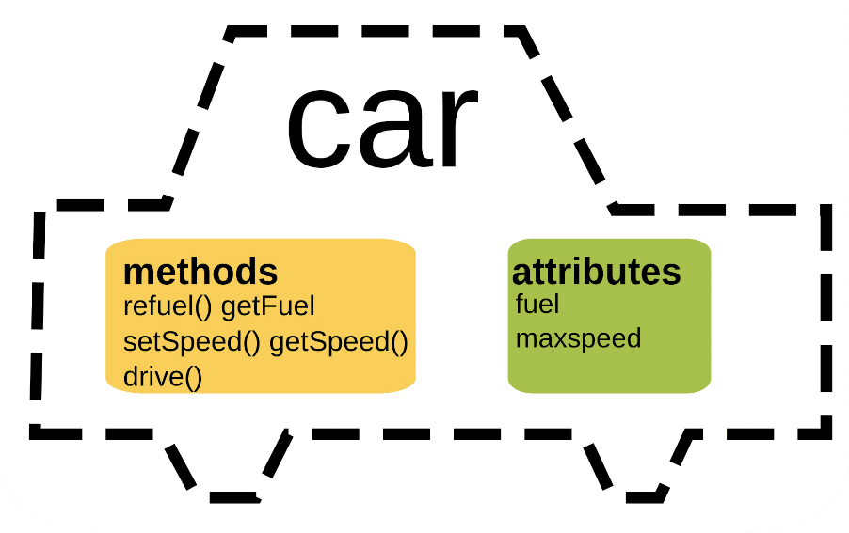
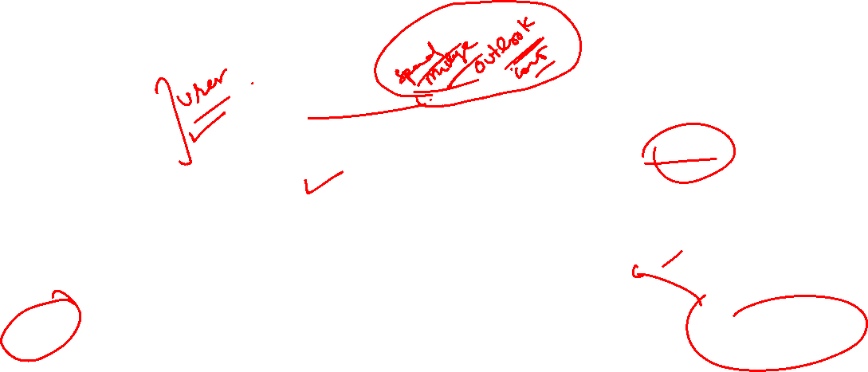
Object Oriented Programming
User is concerned with only working
  What it takes?
  What it does?
  What it returns?
Hide How it actually do that?

Slide 6
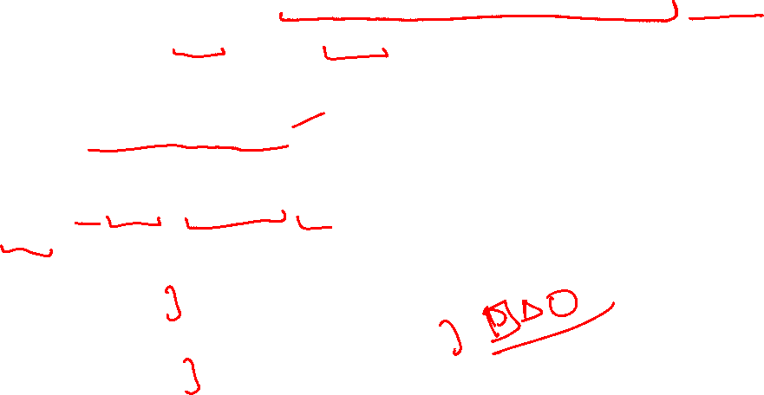
Object Oriented Programming Use
Commonly used to create user defined abstract data types (ADTs)
  Which are very specific Or very general in purpose
Improve built in C++ data types
  Arrays (with boundary checks),
  String (with additional Functionalities)
Create missing datatypes from C++ as if they were built-in data types.
  Matrices (Simple, Triangular, Sparce)
  Sets
Creating objects that perform commonly needed tasks
  Input validation
  Screen output in a graphical user interface
  Voice processing

Slide 7

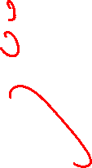
Object Oriented Programming Use
Data types created for a specific application.
For example,
  Student Management System
    Student
    Course
  Hospital Management System
    Doctor
    Patient
    Appointments

